Slide 1
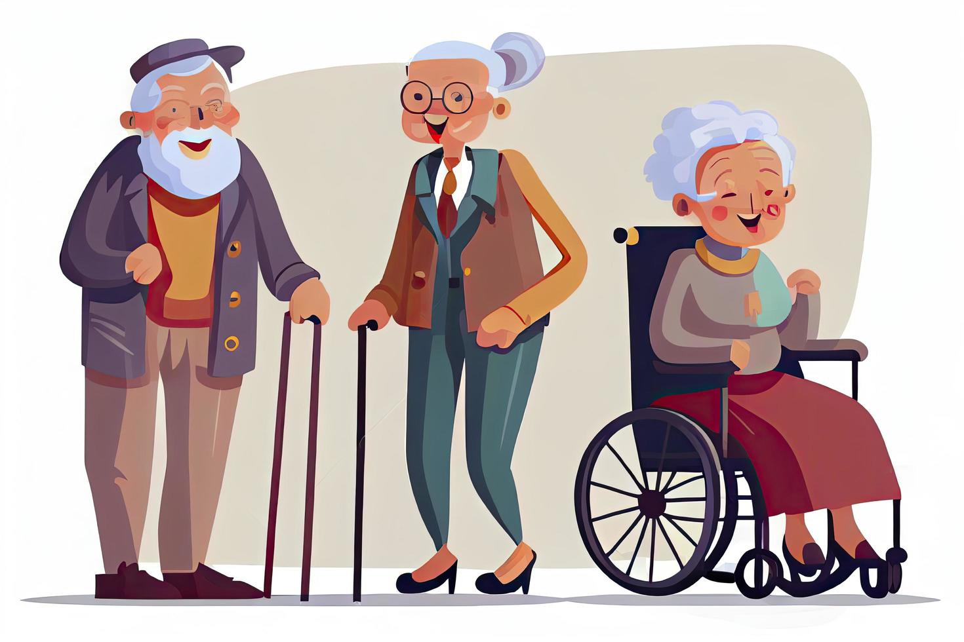
CSL-401 Project 1
Visit + Donation to Baghbaan Old Age Home

Slide 2
Group Members
Muhammad Ahmed Mohsin (Group Lead)
Hassan Rizwan
Muhammad Bilal
Muhammad Umer
Muhammad Hassaan Ghazali

Slide 3
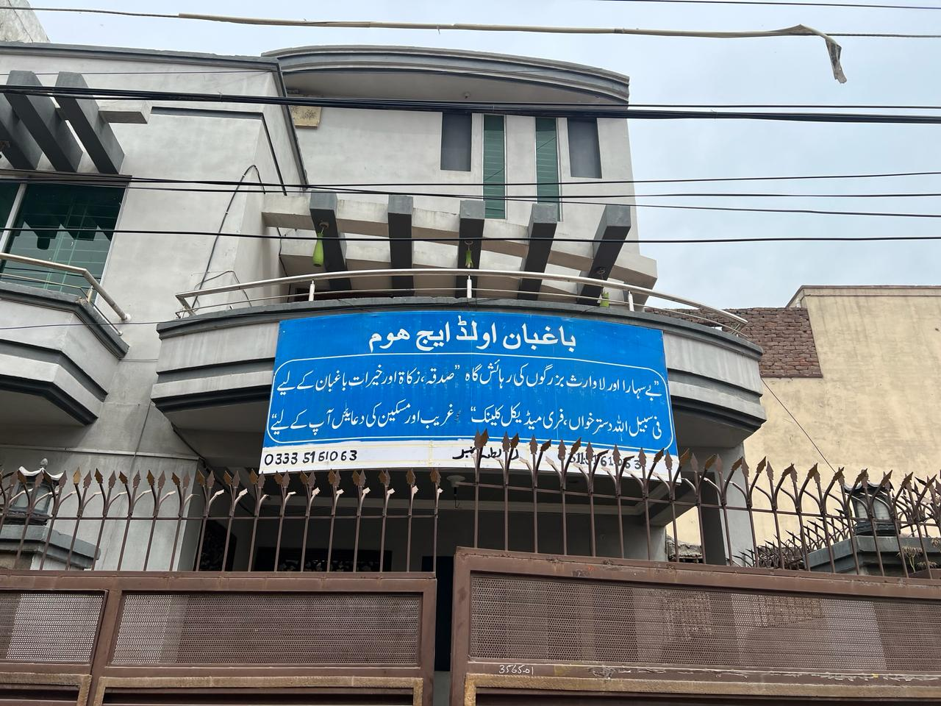
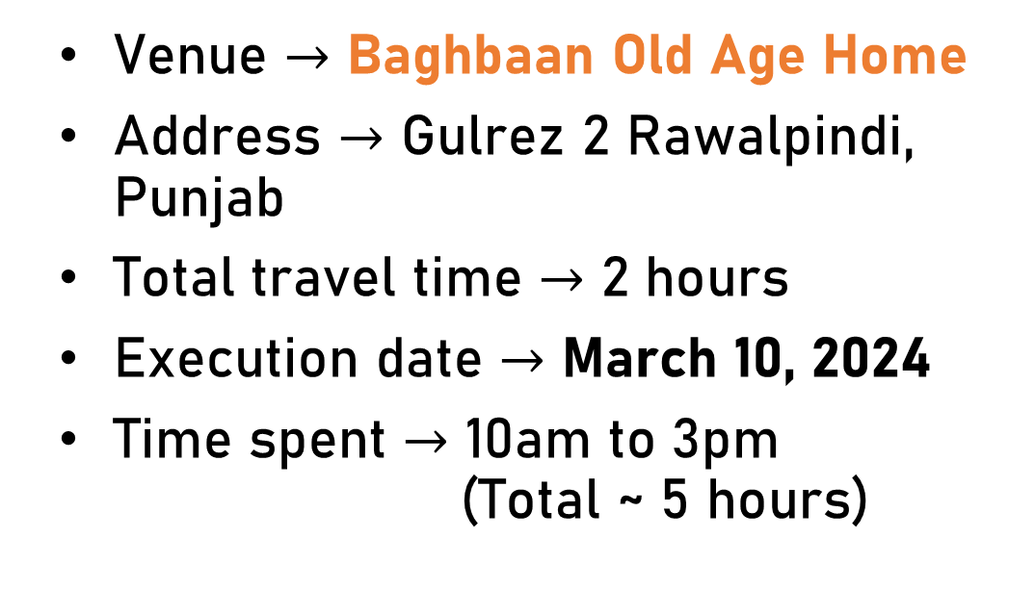
Venue and Date of Execution
Venue $→$ Baghbaan Old Age Home
Address $→$ Gulrez 2 Rawalpindi, Punjab
Total travel time $→$ 2 hours
Execution date $→$ March 10, 2024
Time spent $→$ 10am to 3pm (Total ~ 5 hours)
Ration provided (worth 10k) at personal expense
Fundraising (worth 15k) for donations

Slide 4
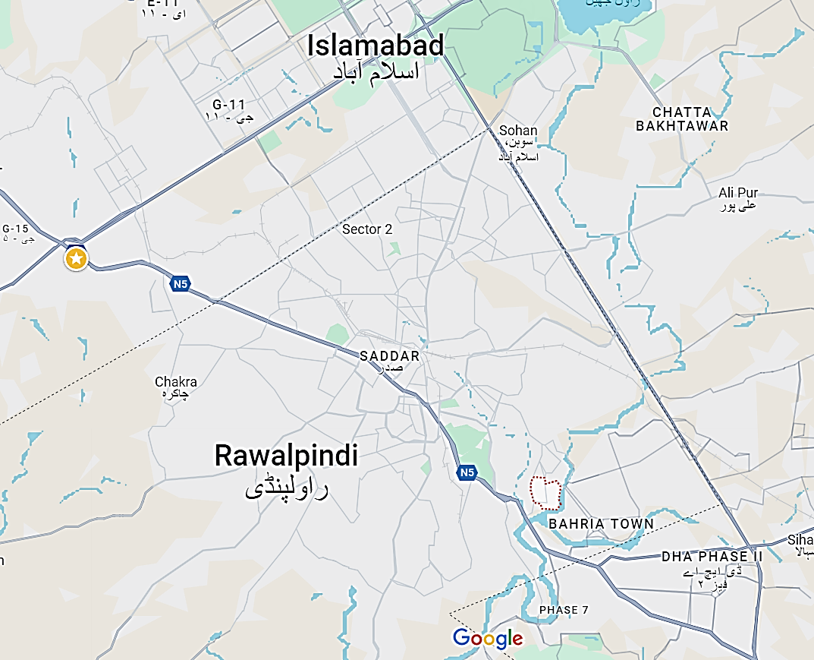
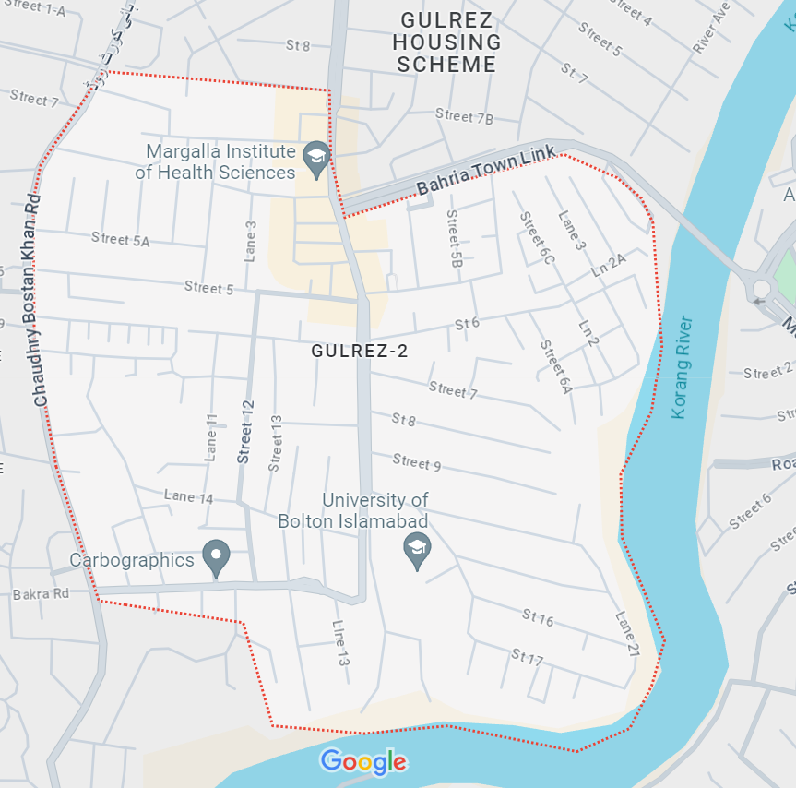

Slide 5
Aims and Objectives of the Project / Relevance / Need of the Project
Objective: Core project aim was to donate ration to the old age home, donate money that we fundraised online from NUST students, and spend time with the elderly citizens
Need: Haji Shaukat Qureshi runs the organization privately and donations from small groups are very valuable for his organization. The organization appreciates donations of food ration, thus we provided essential food items as a donation
“Elderly people are isolated, and their children seldom meet them. Paying them a visit and interacting with them is beneficial for their mental well-being, gives them a break from their routine and make them feel connected to the youth of the society.”
“The elderly get an opportunity to reflect on the life they lived, the decisions they took and also, share their experiences and views on societal issues with younger generations.”

Slide 6
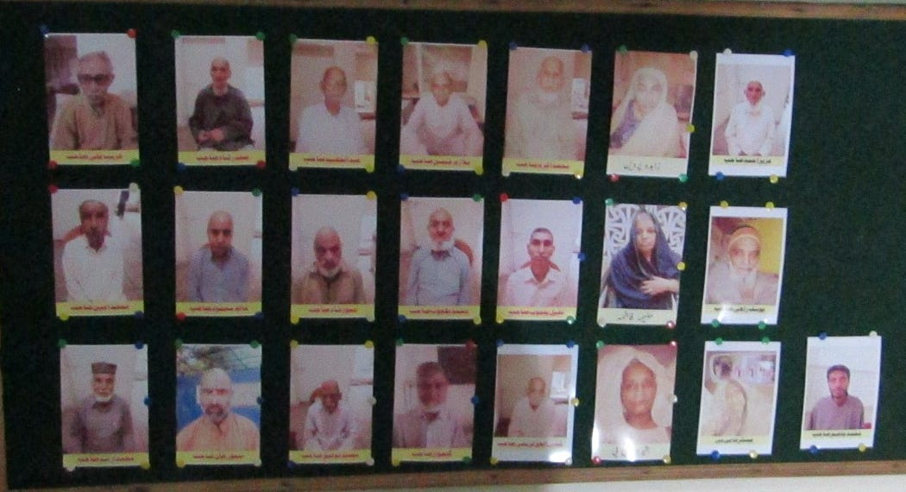
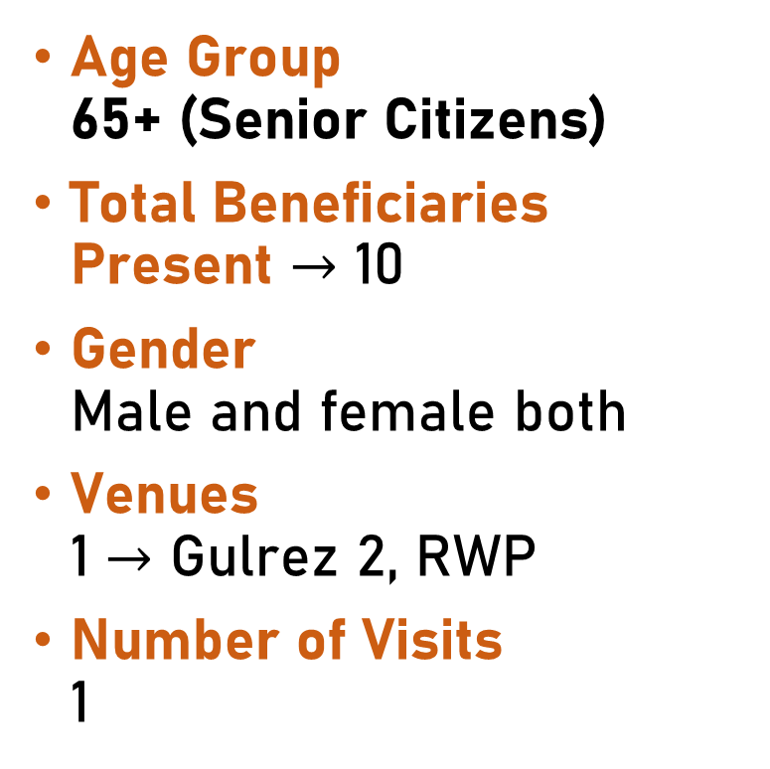
Target Audience
Age Group 65+ (Senior Citizens)
Total Beneficiaries Present $→$ 10
Gender Male and female both
Venues 1 $→$ Gulrez 2, RWP
Number of Visits 1

Slide 7
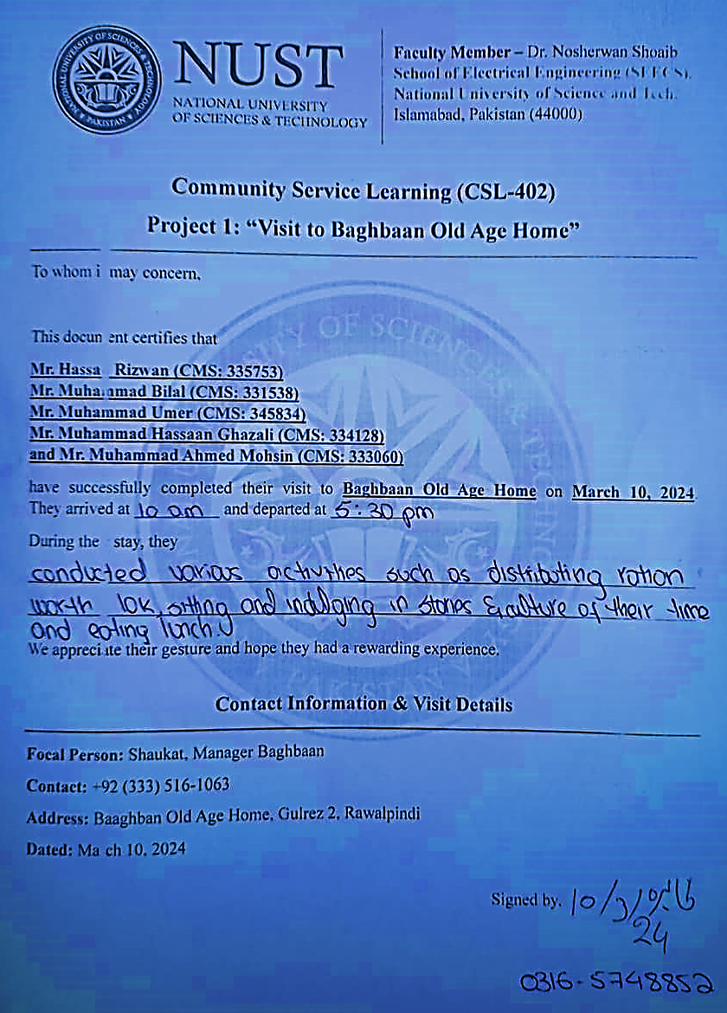
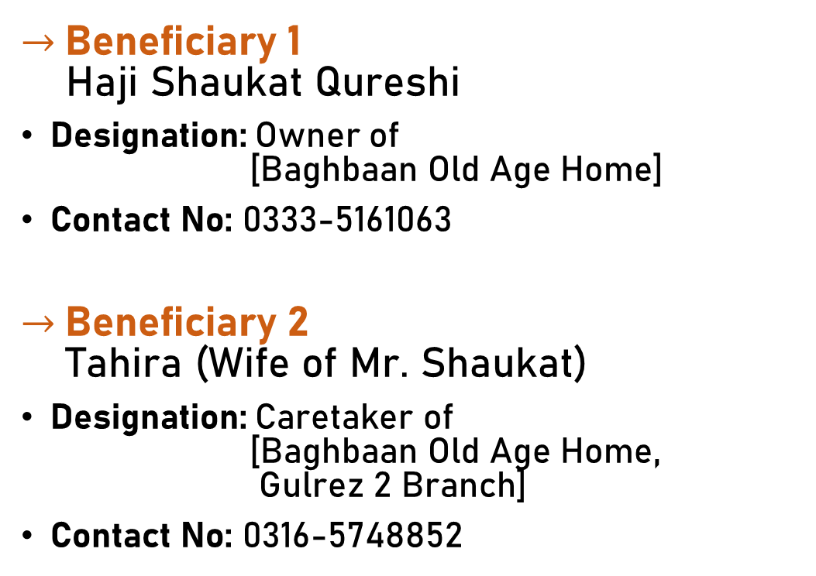
Letter of Acknowledgement
$→$Beneficiary 1 Haji Shaukat Qureshi
Designation: Owner of [Baghbaan Old Age Home]
Contact No: 0333-5161063
$→$Beneficiary 2 Tahira (Wife of Mr. Shaukat)
Designation: Caretaker of [Baghbaan Old Age Home, Gulrez 2 Branch]
Contact No: 0316-5748852

Slide 8
Work Division & Tasks

Slide 9
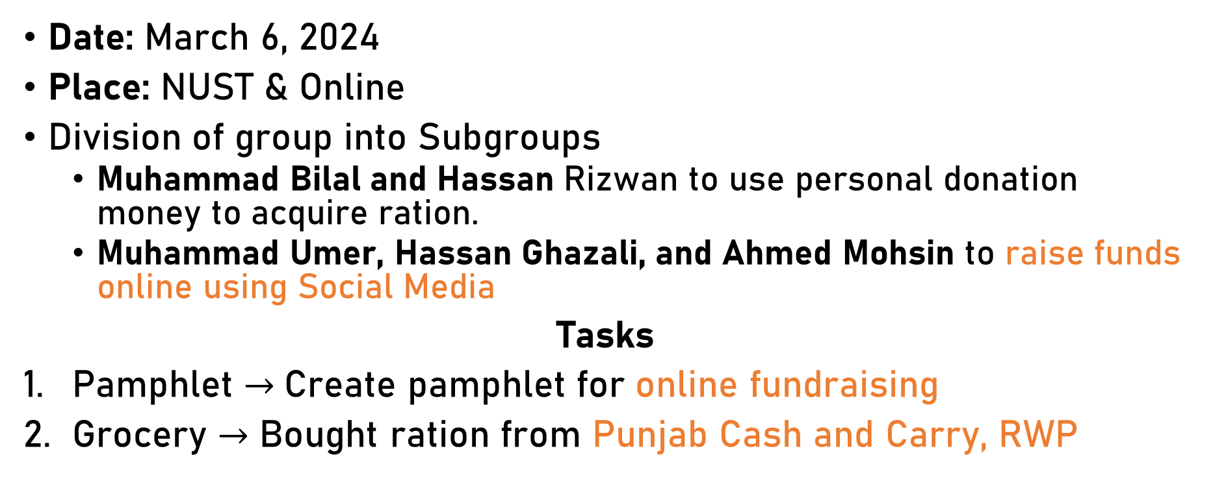
Pre-execution Meetings & Tasks
Date: March 6, 2024
Place: NUST & Online
Division of group into Subgroups
Muhammad Bilal and Hassan Rizwan to use personal donation money to acquire ration.
Muhammad Umer, Hassan Ghazali, and Ahmed Mohsin to raise funds online using Social Media
Tasks
Pamphlet $→$Create pamphlet for online fundraising
Grocery $→$ Bought ration from Punjab Cash and Carry, RWP

Slide 10
Work Division Pre-execution
Name | Task | Hours / person
Hassan Rizwan | Acquiring ration from store -> Day of execution activities | 5+5
Muhammad Bilal
Muhammad Umer | Fundraising online via social media channels PKR 15,000/- -> Day of execution activities | 5+5
Muhammad Hassaan Ghazali
Muhammad Ahmed Mohsin

Slide 11
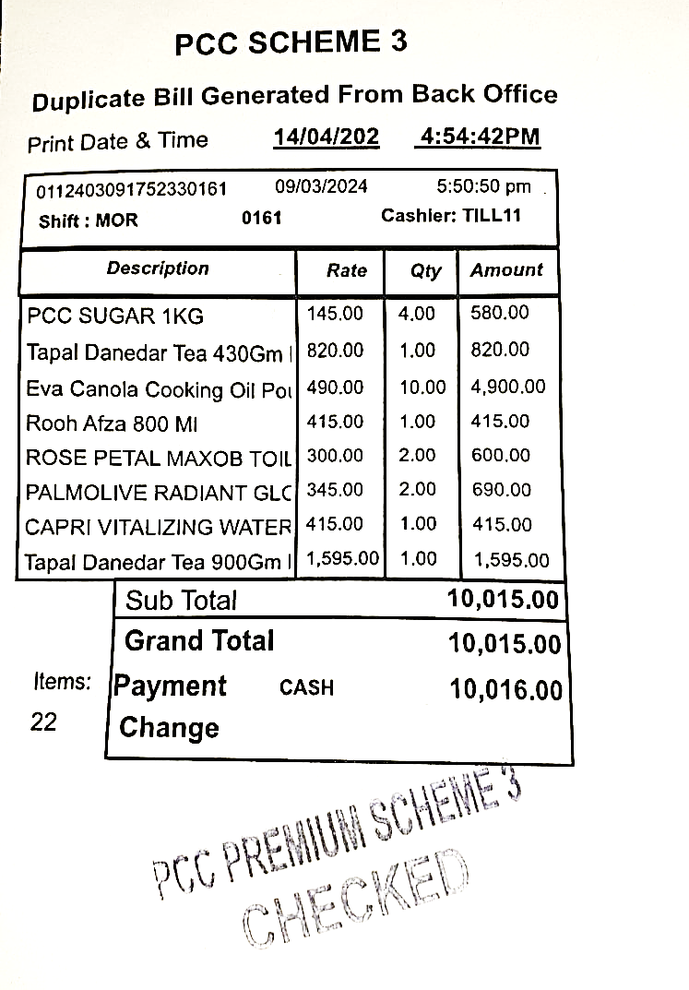

Grocery
Pamphlet

Slide 12
Relevant Areas Covered
Relevant Area | No. of Hours | Team Members
Leadership & Social Skills | 10 | Muhammad Ahmed Mohsin, Hassan Rizwan
Basic Human Values, Human Rights & Religious Moderation | 10 | Muhammad Umer, Muhammad Bilal, Muhammad Hassaan Ghazali
Education for Empowerment | 0 | N/A
Social Well-Being | 0 | N/A
Disaster Relief & Response | 0 | N/A

Slide 13
Finance Balance Sheet & Cost Analysis

Slide 14
 | Amount (group) in PKR | Amount (per person) in PKR
Fundraising | 15,000/- | 3,000/-
Ration Supplied (donation) | 10,000/- | 2,000/-
Transportation Costs | 5000/- | 100/-
Total Cost | 30,000/- | 6000/-
Ration Item | Cost (PKR)
Tea Leaves | 2415/-
Sugar | 580/-
Oil | 4900/-
Rooh Afza | 415/-
Tissue | 600/-
Soap | 690/-
Water | 415/-
Total | 10,015/-

Slide 15
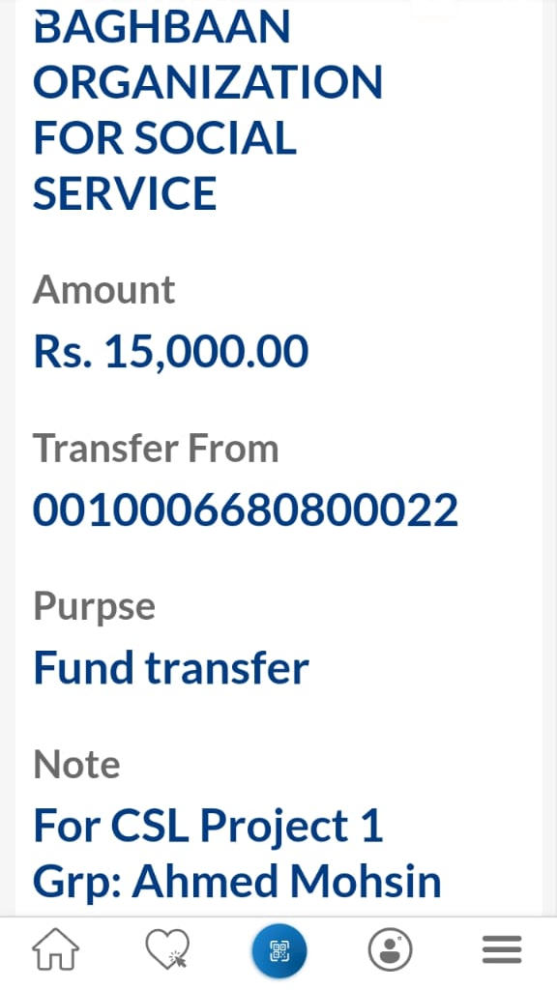

Slide 16
Proof of Presence (Pictures and Video Clips)

Slide 17
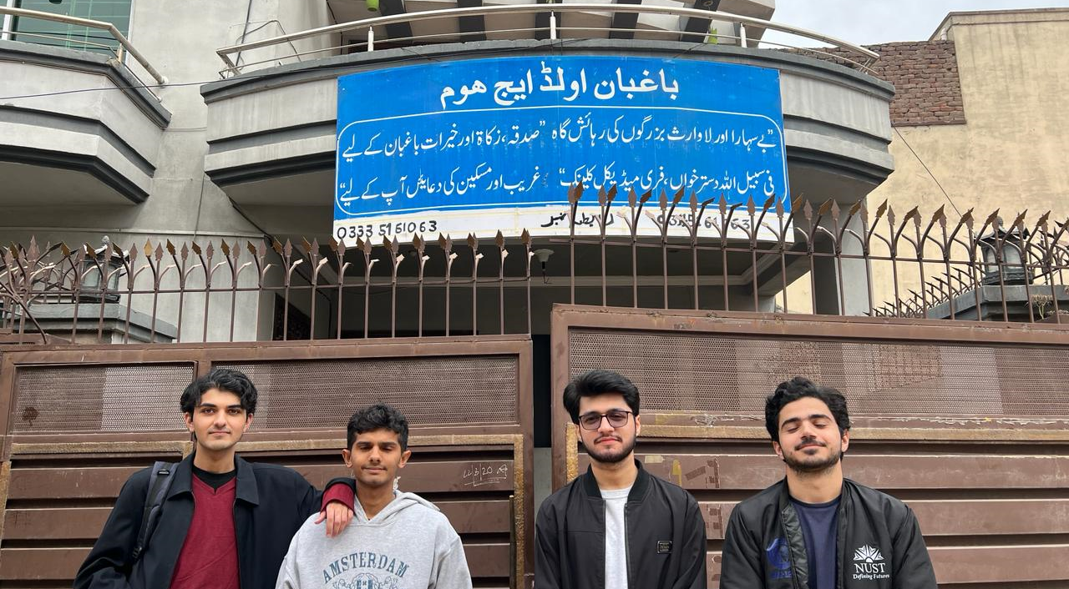

Slide 18
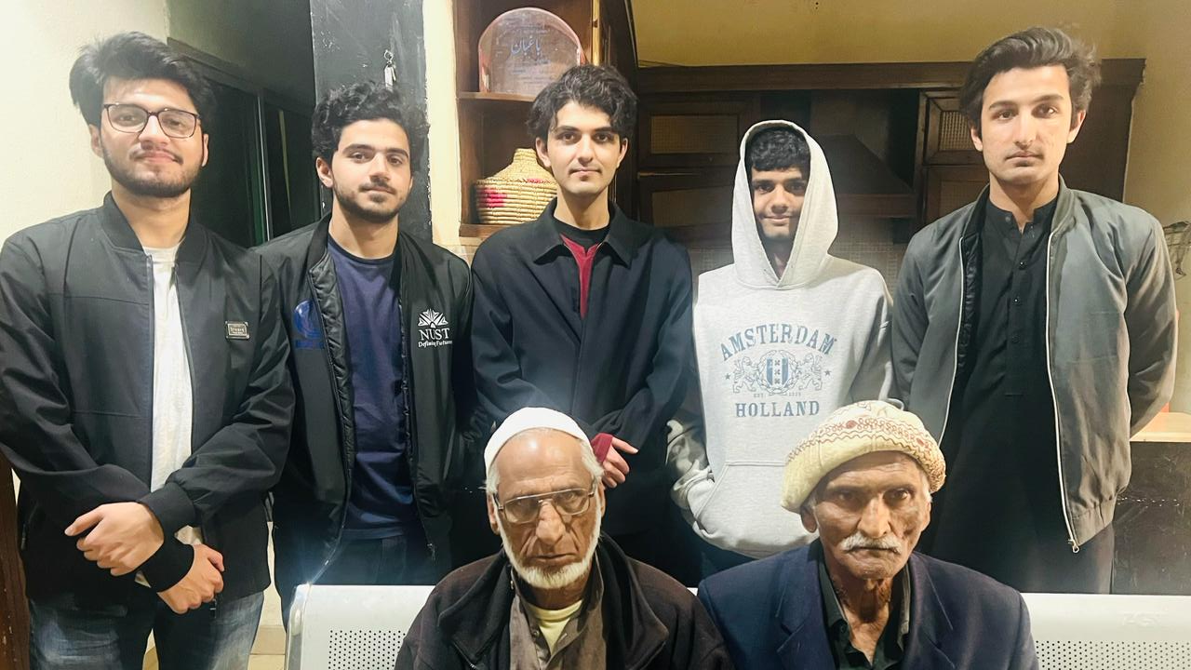

Slide 19
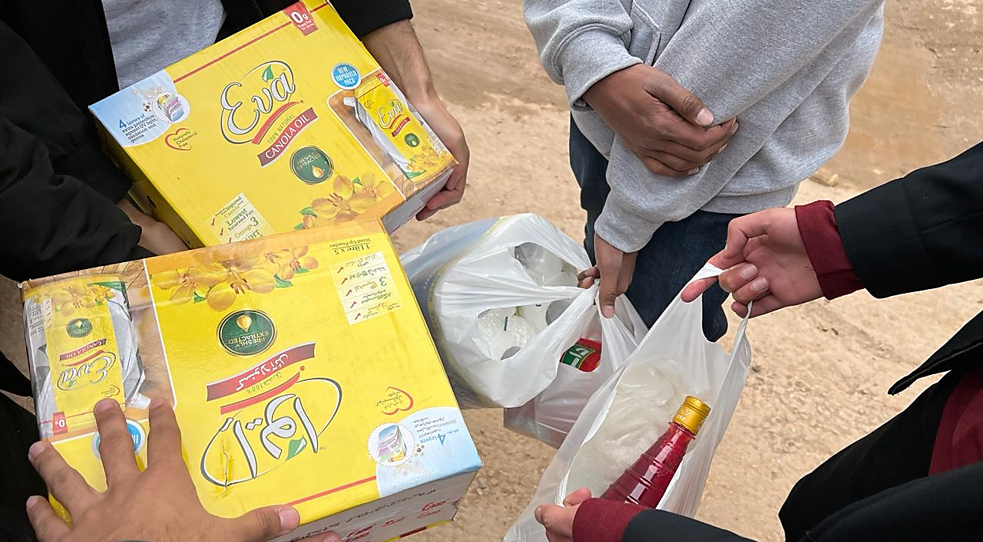

Slide 20
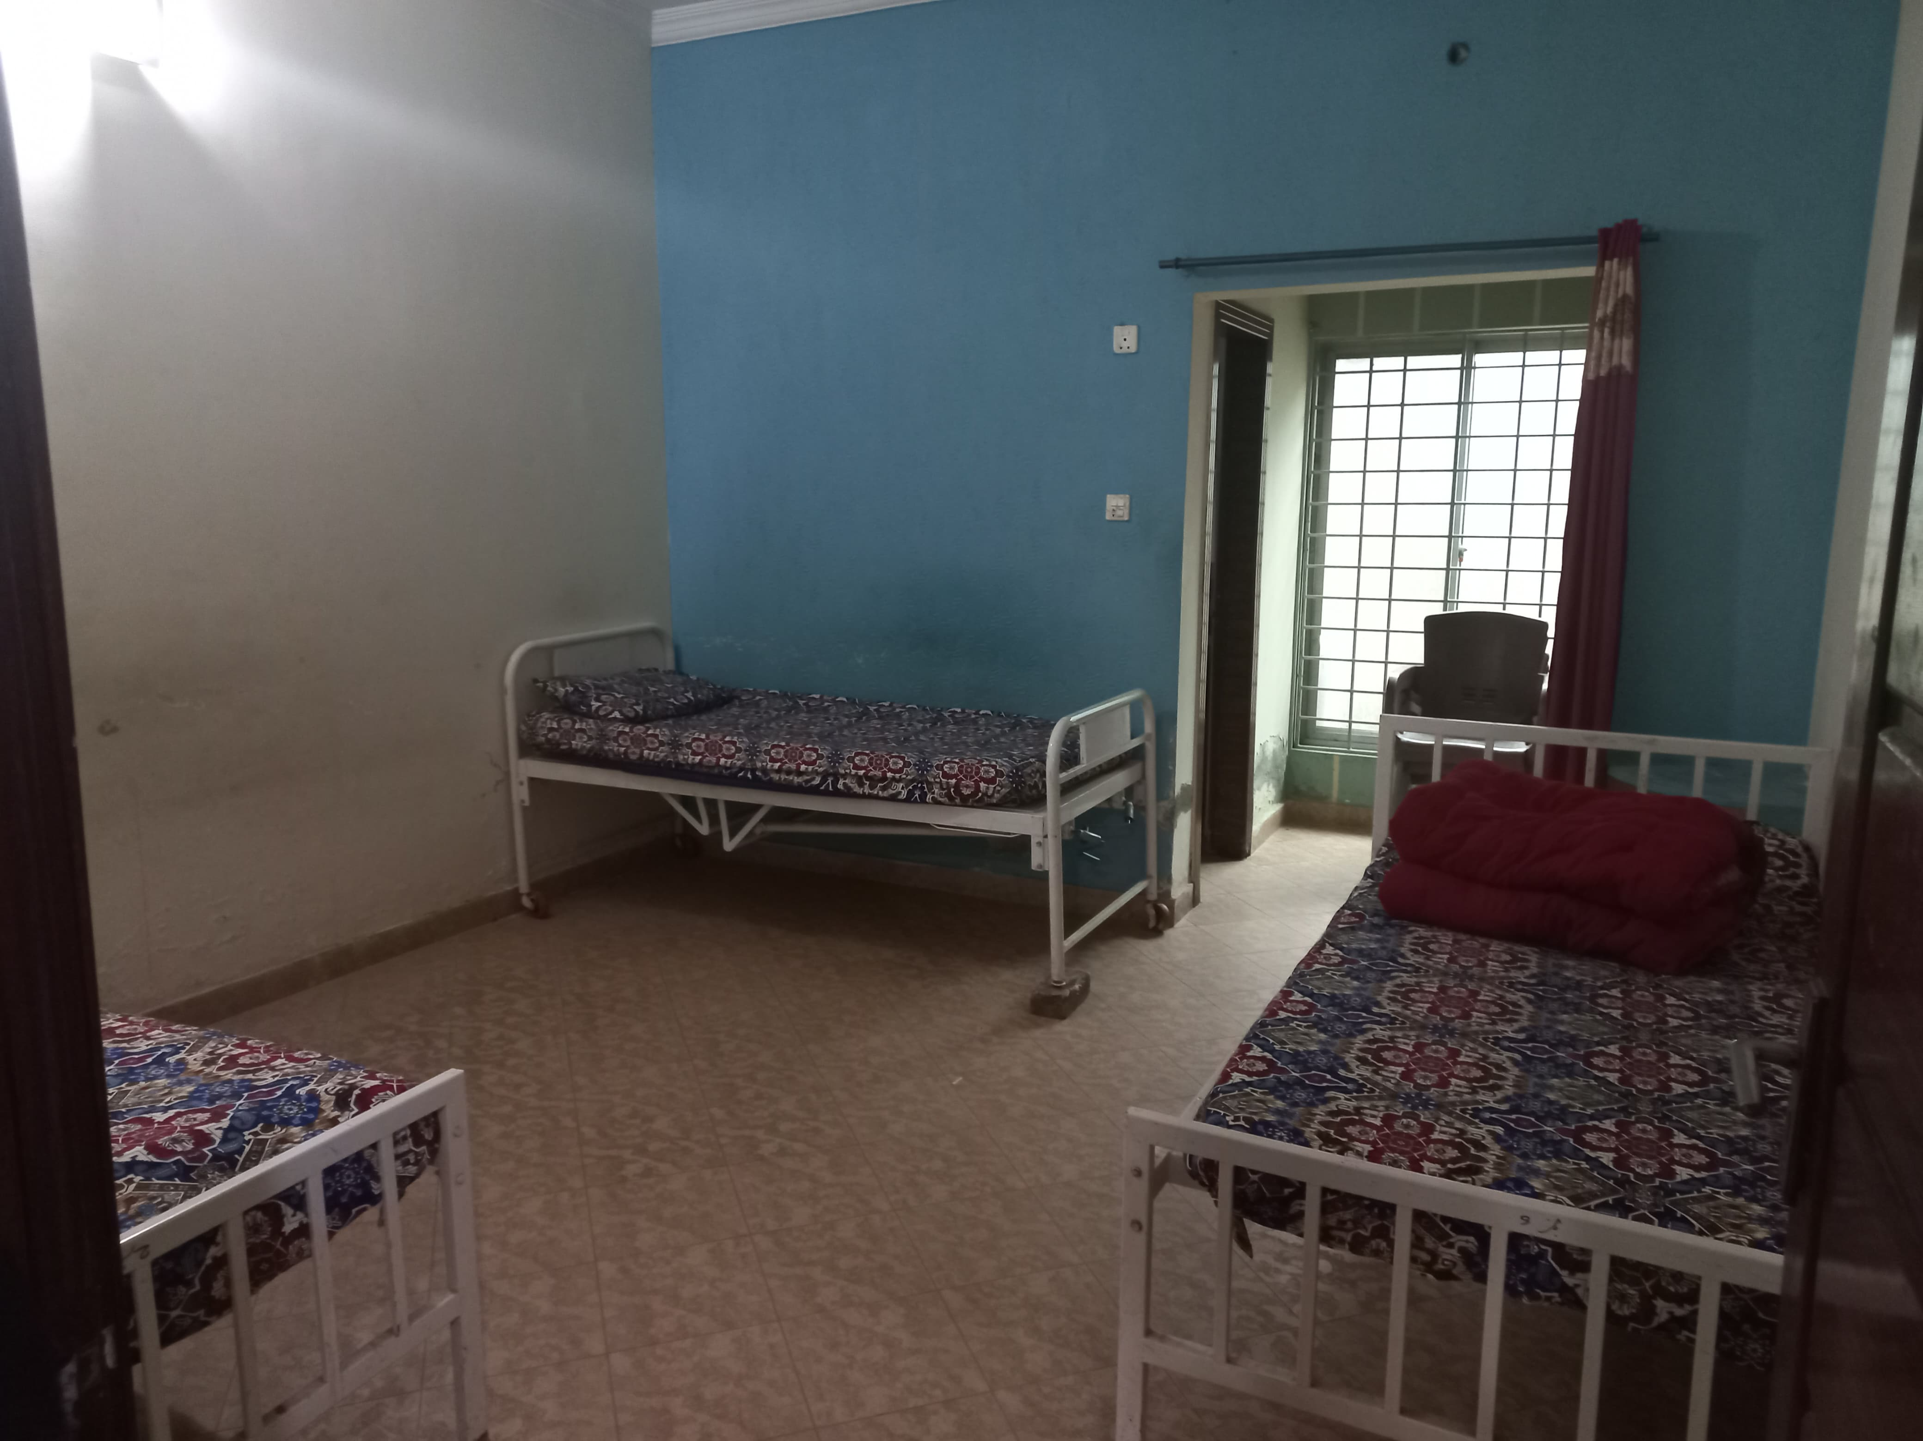
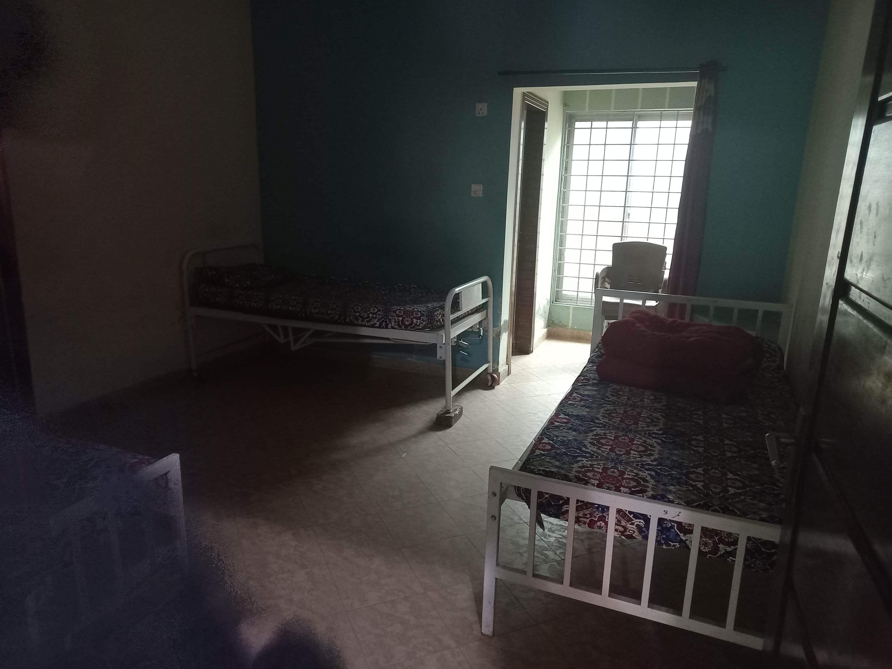
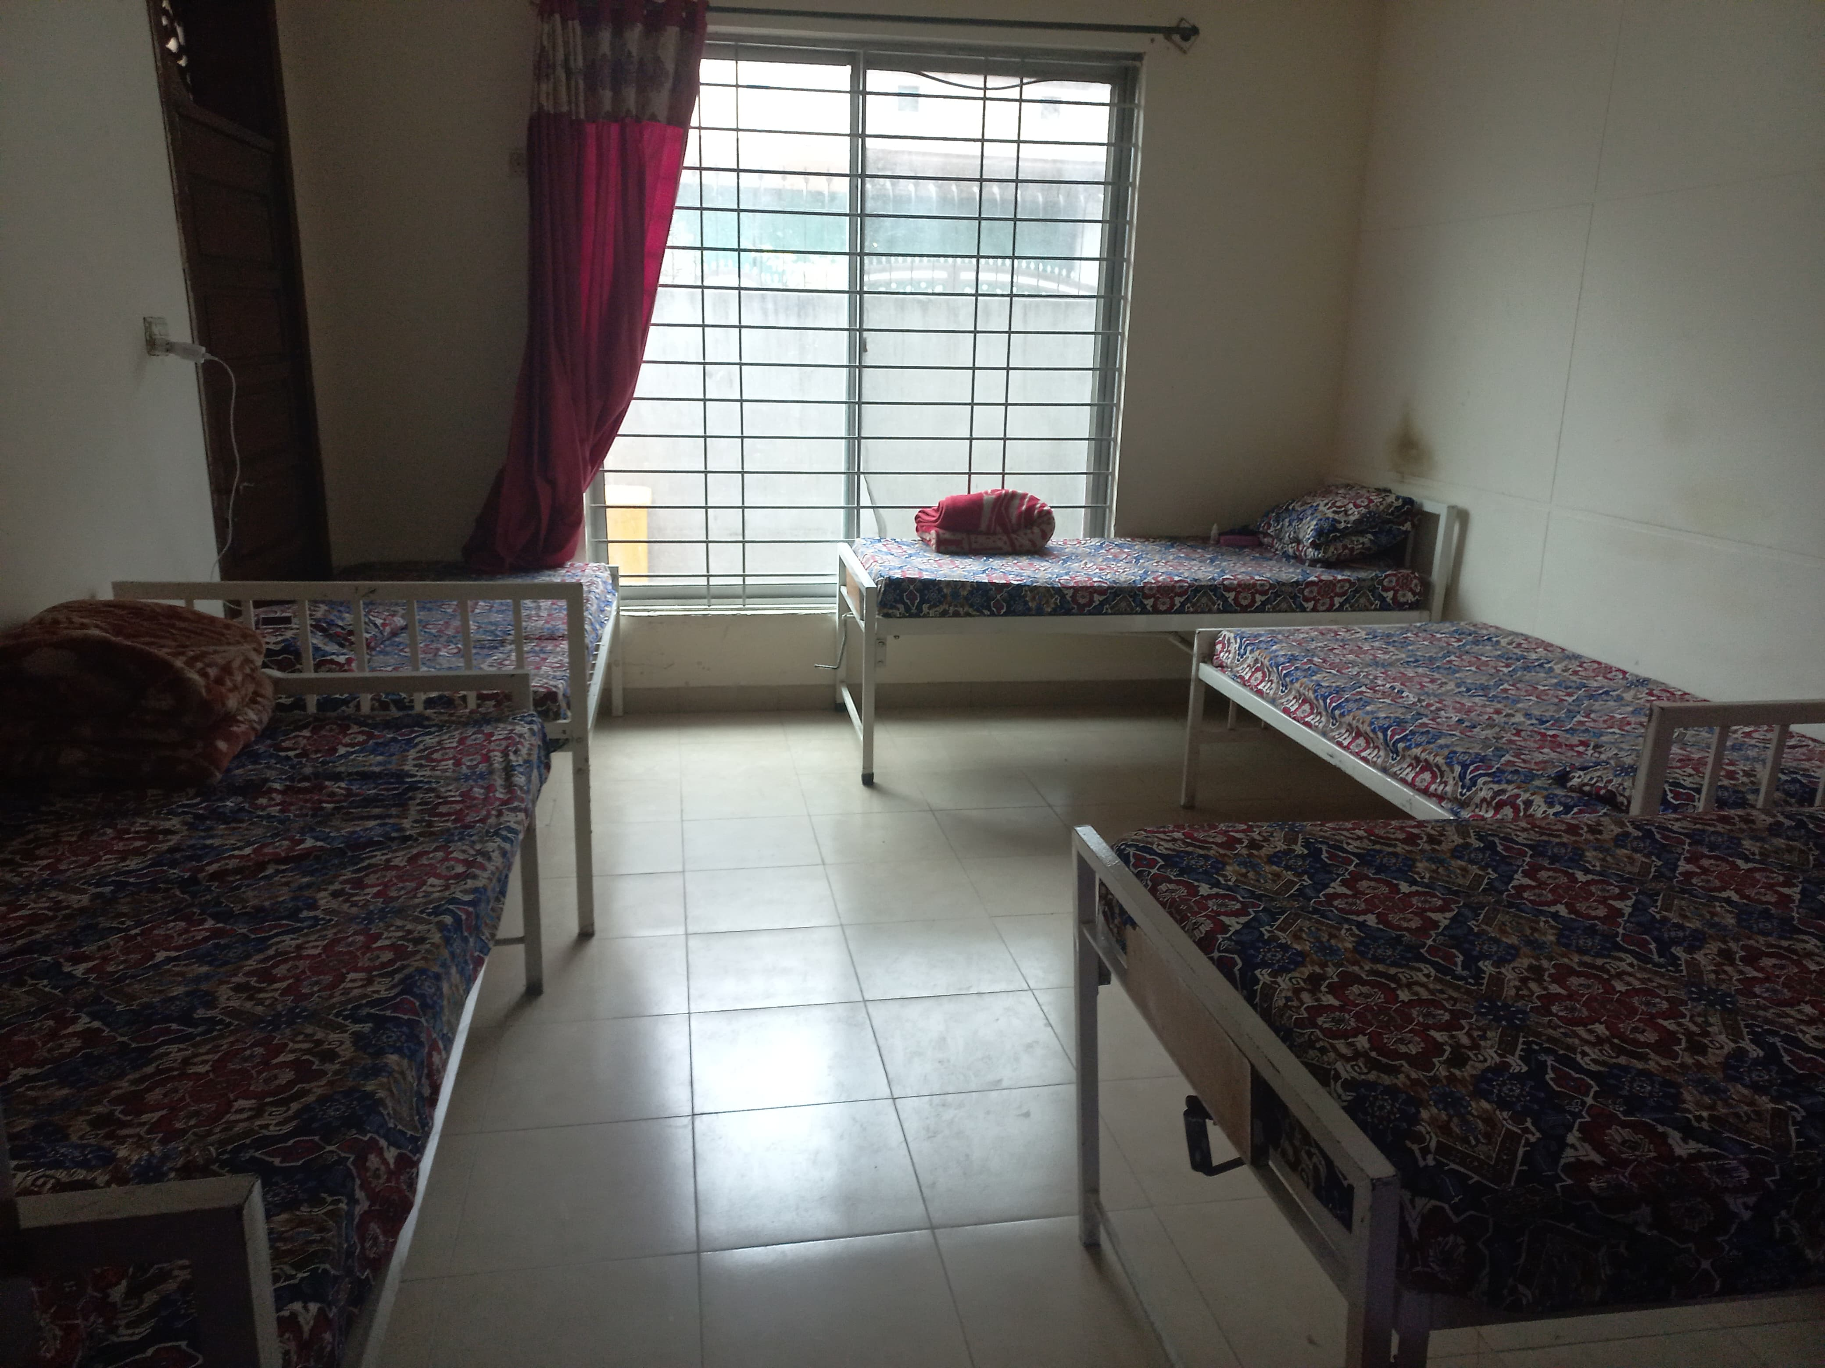

Slide 21
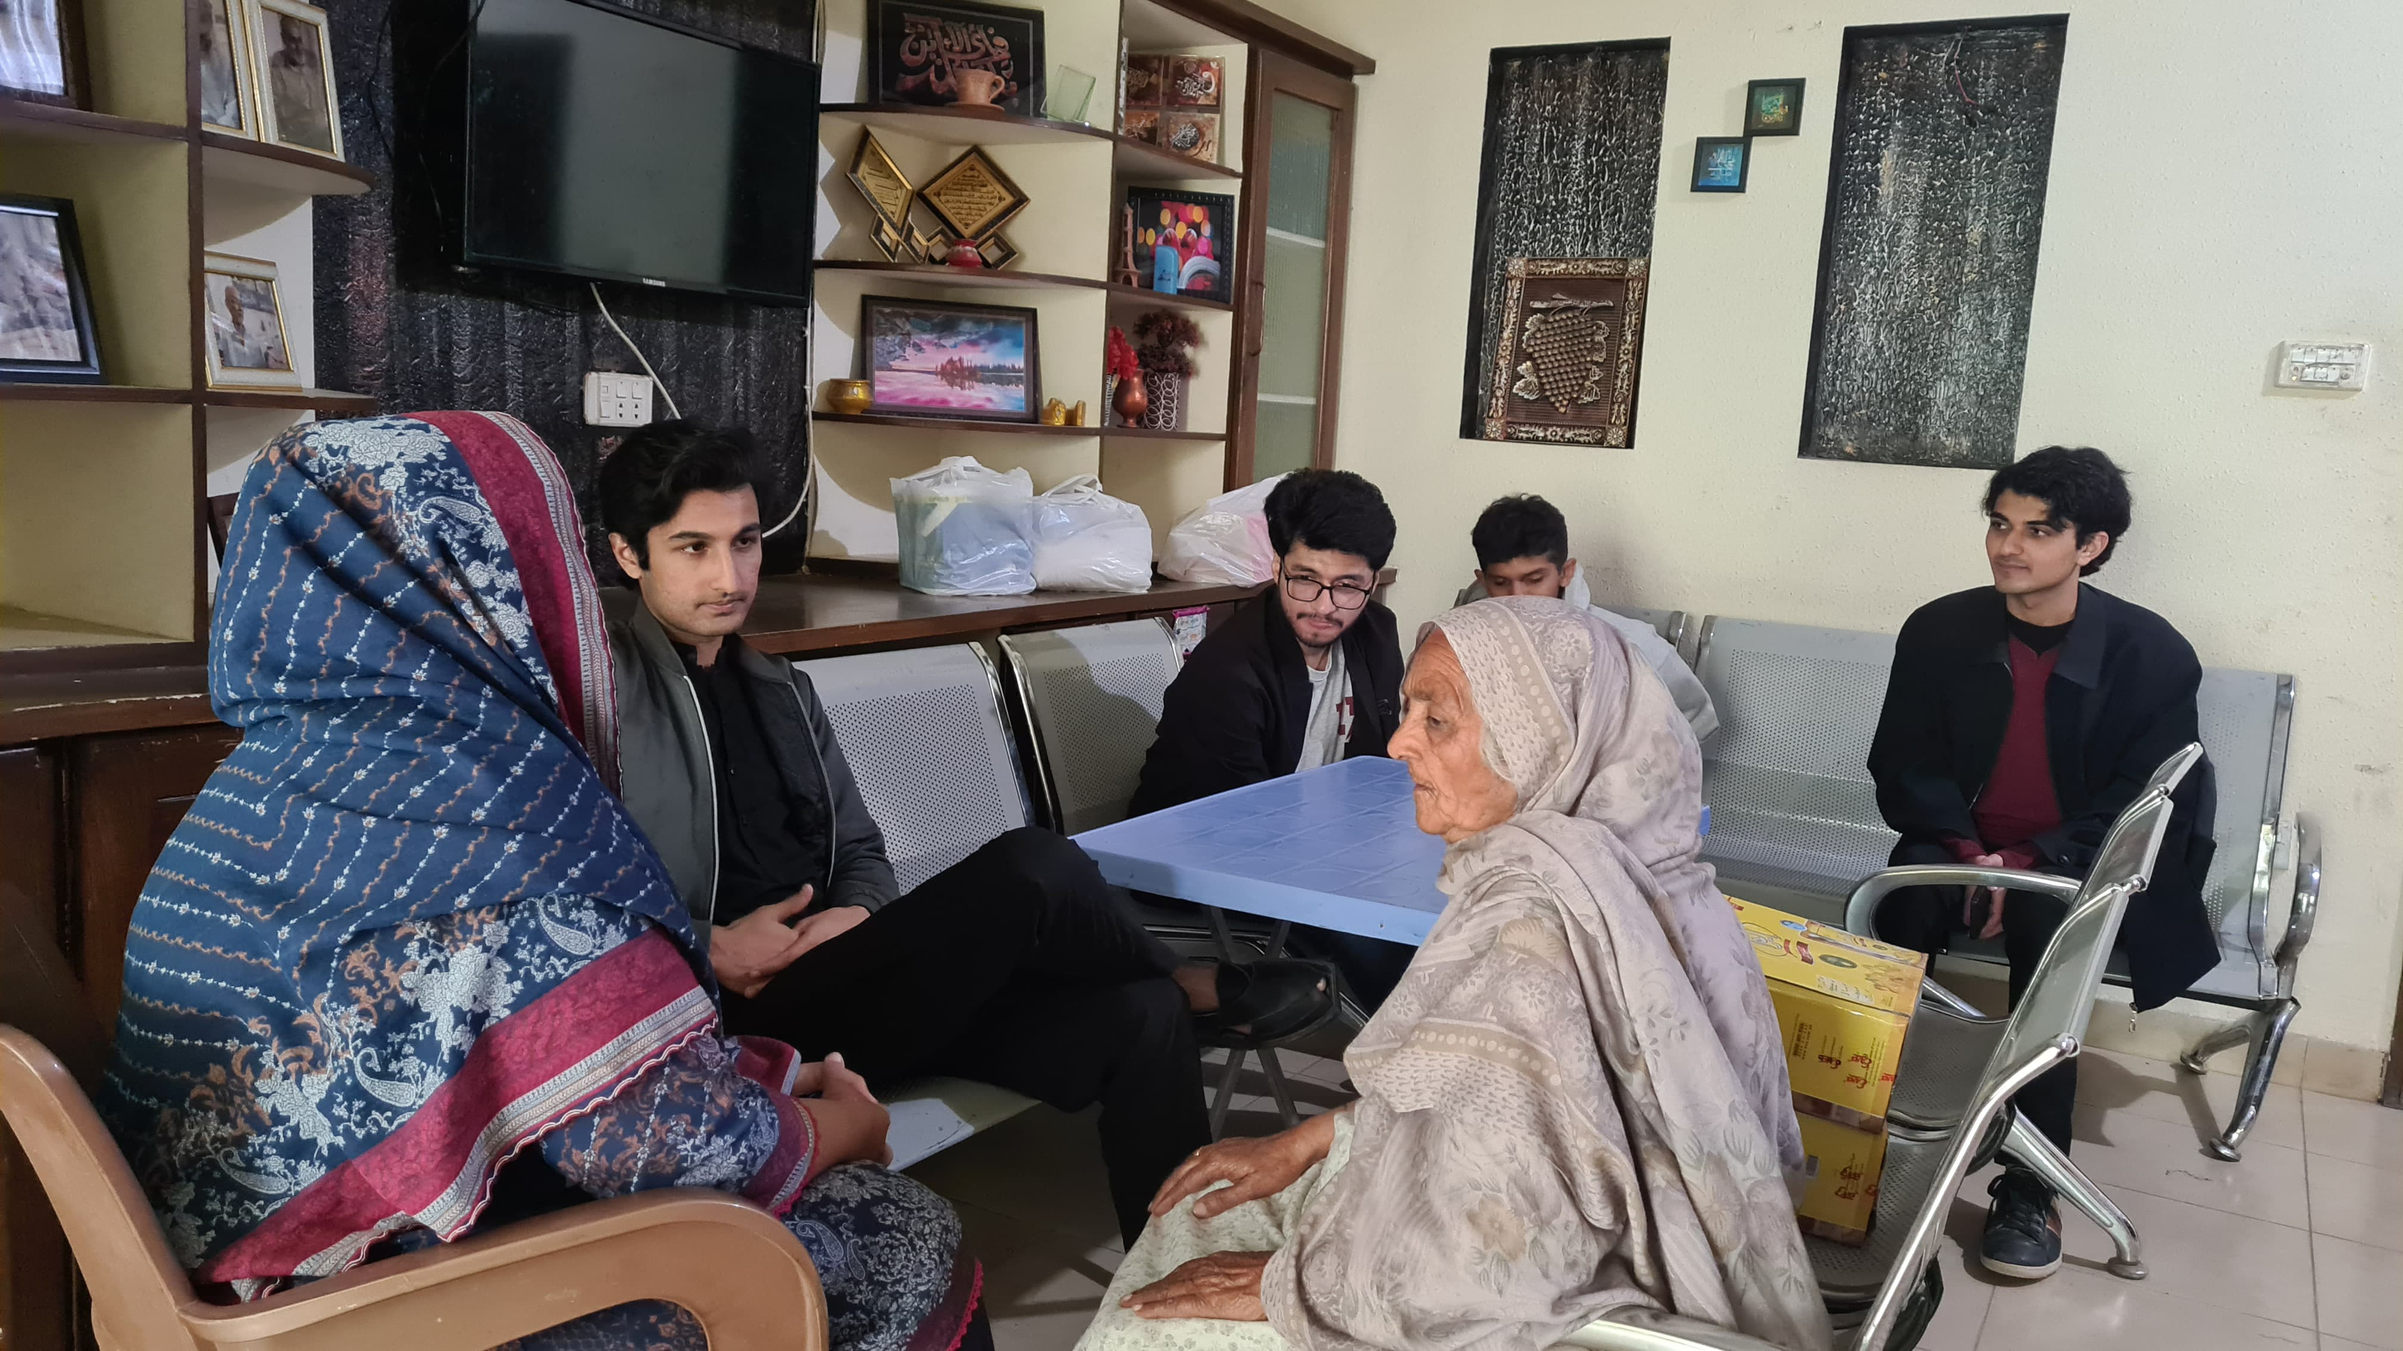

Slide 22
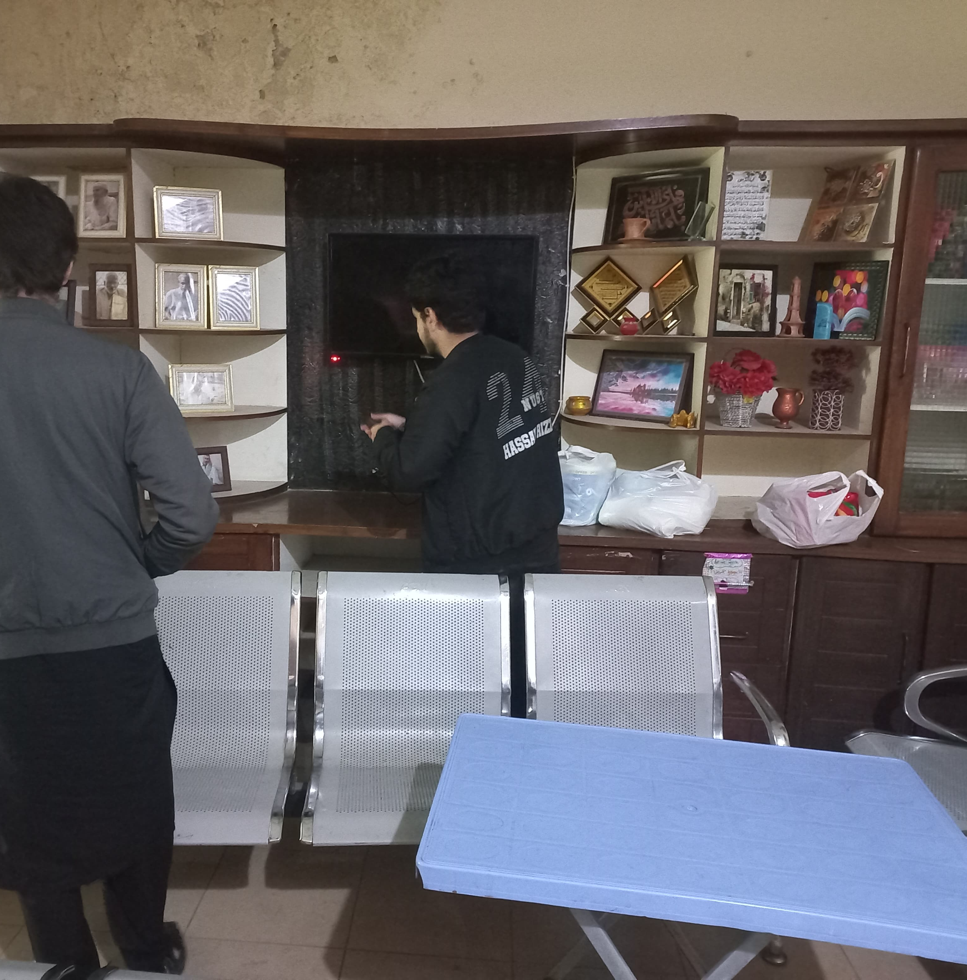
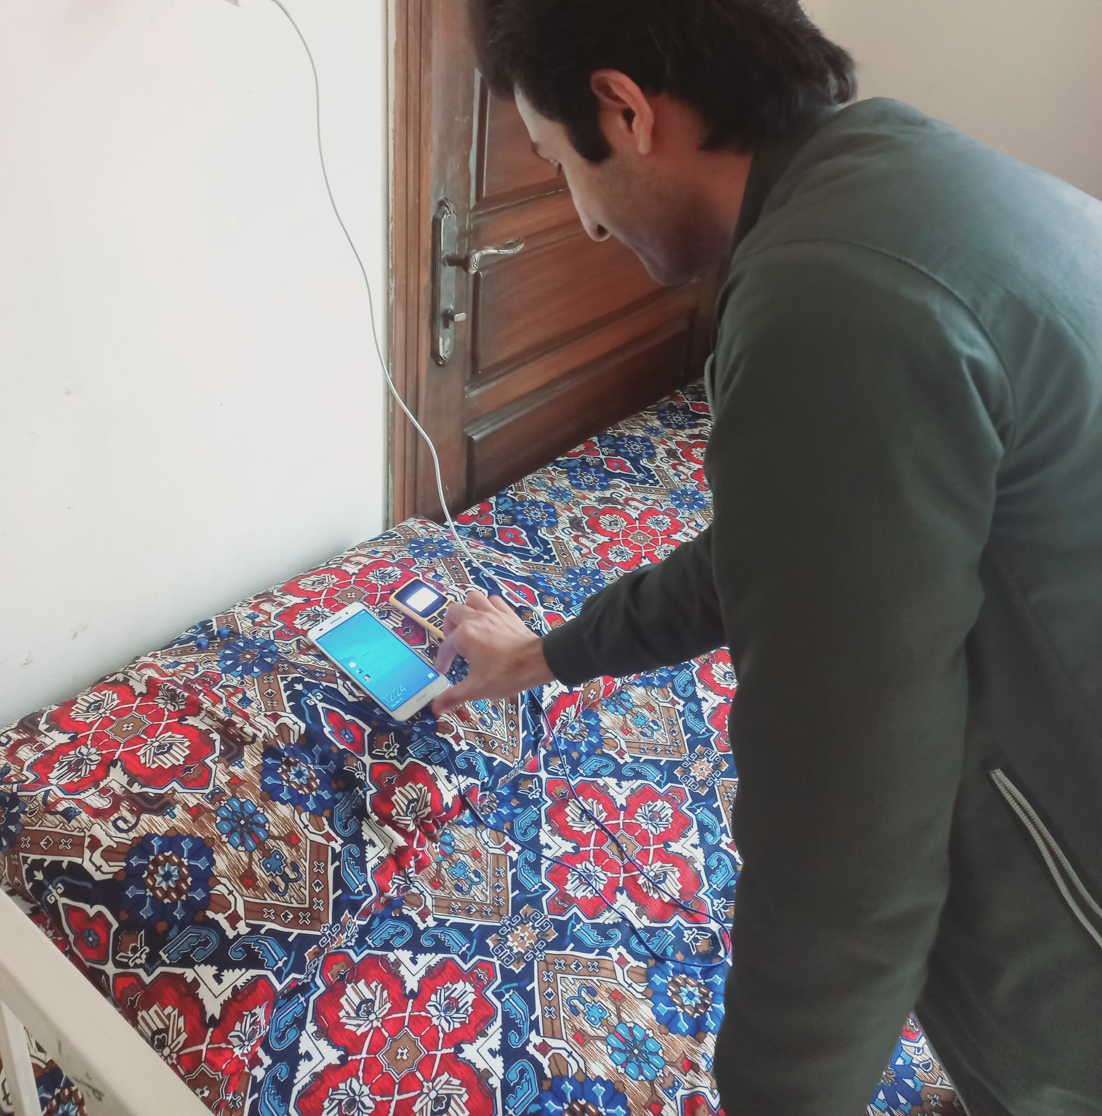

Slide 23
A Paragraph of 150-200 Words

Slide 24
Visit to Old Age Home
The project was carried out by 5 students of BEE12 to provide emotional support and donation (food and money) to the elderly currently residing at Baghbaan Old Age Home led by Haji Shaukat.
The old age home is located at Gulrez 2 Rawalpindi and houses 21 adults. The elderly people were aged over 65 years. The first stage of the project was to collect funds to donate to the organization followed by acquisition of food ration from our personal spending that was also provided to the organization.
Acquiring food ration was done on March 9, 2024, and the fundraised amount had also been collected by that time and the trip was done on March 10, 2024. The activity was completed due to the efforts of the entire team and the team donated a total of PKR 25k from students of NUST and personal donations (10k).
The ration items were acquired from Punjab C&C, RWP and contained grocery essentials: tea leaves, oil, sugar, Rooh Afza, tissue rolls, soap etc. The 15k fundraised amount was provided to the organization as is so they can be utilized in whichever manner they deemed most important and beneficial.

Slide 25
Thank you!

